Slide 1
CTM 1A
Sections 15.3 Solving Quadratic Equations Using Completing the Square or the Quadratic Formula

Slide 2
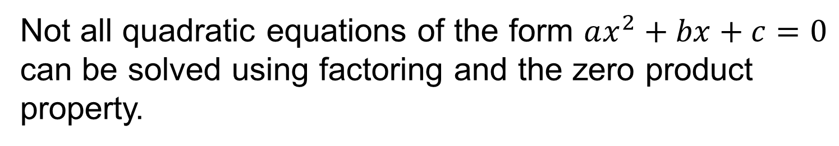
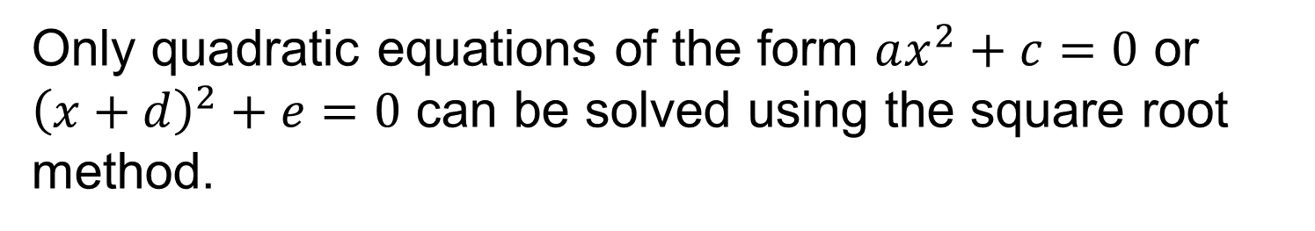
Completing the Square
Only quadratic equations of the form $ax^{2}+c=0$ or ${\left(x+d\right)}^{2}+e=0$ can be solved using the square root method.
Not all quadratic equations of the form $ax^{2}+bx+c=0$ can be solved using factoring and the zero product property.
Therefore, mathematicians needed to develop a general method to solve quadratic equations.

Slide 3



Completing the Square
The process of completing the square involves transforming $ax^{2}+bx+c=0$ into ${\left(x+d\right)}^{2}=e$.
$$2x^{2}−8x−10=0$$
$$2x^{2}−8x−10=0$$
$${\left(x−4\right)}^{2}=5$$

Slide 4
Completing the Square
This transformation involves four steps.

Slide 5
Completing the Square
This transformation involves four steps.
1) Isolate the variable terms on one side of the equation

Slide 6
Completing the Square
This transformation involves four steps.
1) Isolate the variable terms on one side of the equation
2) Reduce the leading coefficient to 1

Slide 7
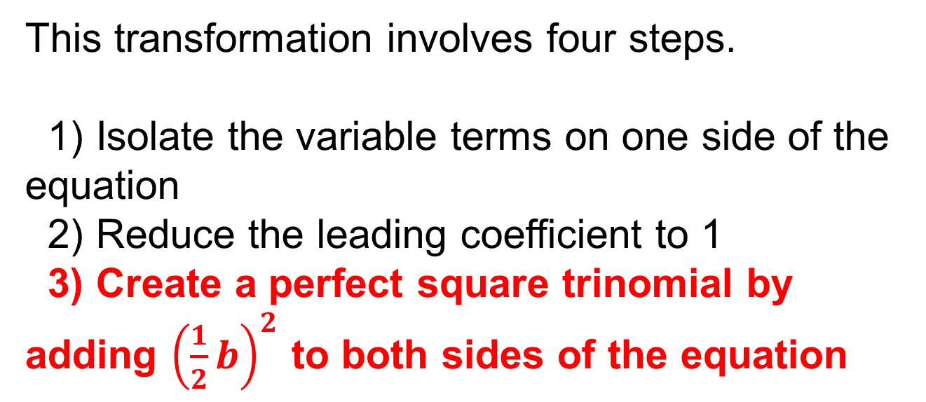
Completing the Square
This transformation involves four steps.
1) Isolate the variable terms on one side of the equation
2) Reduce the leading coefficient to 1
3) Create a perfect square trinomial by adding ${\left(\frac{1}{2}b\right)}^{2}$ to both sides of the equation

Slide 8
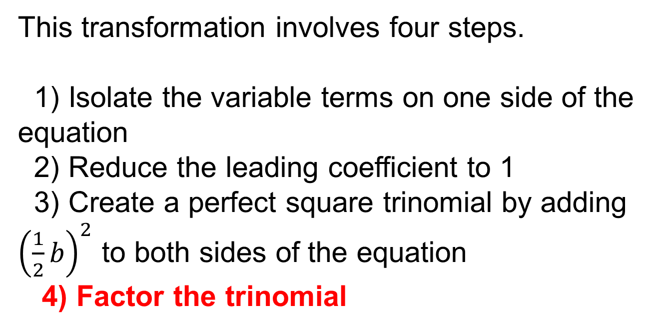
Completing the Square
This transformation involves four steps.
1) Isolate the variable terms on one side of the equation
2) Reduce the leading coefficient to 1
3) Create a perfect square trinomial by adding ${\left(\frac{1}{2}b\right)}^{2}$ to both sides of the equation
4) Factor the trinomial

Slide 9
Completing the Square
Once the transformation of the equation is complete, use the square root method to solve the quadratic equation.

Slide 10
Completing the Square
When the radicand is a non-perfect square, the solutions can be stated as exact or approximate.
Exact solutions contain the simplified radical (square root)
Approximate solutions use the decimal approximations of the radical (square root)

Slide 11


Completing the Square
Solve each quadratic equation by completing the square. Give both the exact and approximate solutions. (Examples)
$${a) x}^{2}+2x−48=0$$
$$b) x^{2}−8x+9=0$$

Slide 12


Completing the Square
Solve each quadratic equation by completing the square. Give both the exact and approximate solutions. (Examples)
$${c) 2x}^{2}−92=8x$$
$$d) {5x}^{2}−11x+2=0$$

Slide 13


Completing the Square
Solve each quadratic equation by completing the square. Give both the exact and approximate solutions. (Skill Check)
$$a) x^{2}−10x+24=0$$
$$Exact: x=4 or x=6$$

Slide 14


Completing the Square
Solve each quadratic equation by completing the square. Give both the exact and approximate solutions. (Skill Check)
$$b) x^{2}−24=−2x$$
$$Exact: x=−4 or x=6$$

Slide 15

Completing the Square
Solve each quadratic equation by completing the square. Give both the exact and approximate solutions. (Skill Check)
$${c) 2x}^{2}−4x−46=0$$
$$Exact:x=1−2\sqrt{6} or x=1+2\sqrt{6}$$
$$Approximate: x≈−3.9 or x≈5.9$$

Slide 16
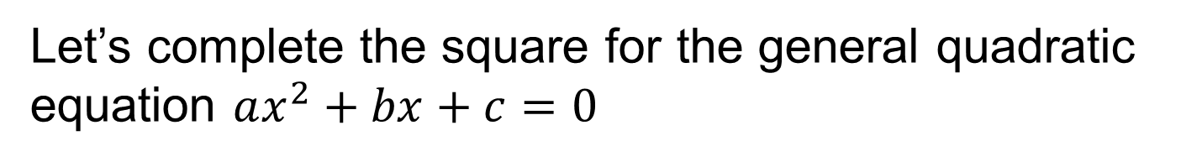
Completing the Square
Let’s complete the square for the general quadratic equation $ax^{2}+bx+c=0$

Slide 17
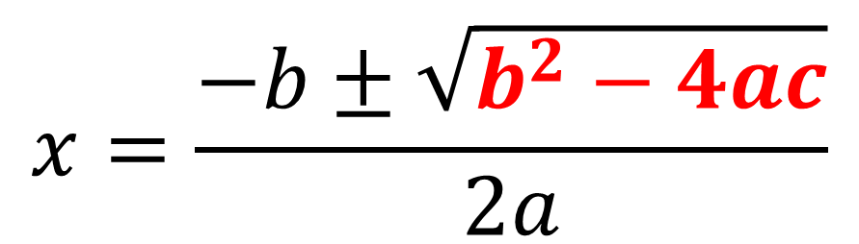
The Quadratic Formula!
$$x=\frac{−b±\sqrt{b^{2}−4ac}}{2a}$$
$$b^{2}−4ac is called the discriminant$$

Slide 18



The Quadratic Formula!
Solve each quadratic equation using the quadratic formula. Give both exact and approximate answers. (Examples)
$$a) 3x^{2}−7x−6=0$$
$$3x^{2}−7x−6=0$$
$$a=3 b=−7 c=−6$$

Slide 19

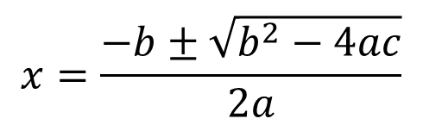
The Quadratic Formula!
Solve each quadratic equation using the quadratic formula. Give both exact and approximate answers. (Examples)
$$a) 3x^{2}−7x−6=0$$
$$a=3 b=−7 c=−6$$
$$x=\frac{−b±\sqrt{b^{2}−4ac}}{2a}$$

Slide 20
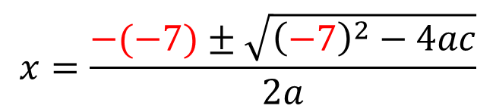
The Quadratic Formula!
Solve each quadratic equation using the quadratic formula. Give both exact and approximate answers. (Examples)
$$a) 3x^{2}−7x−6=0$$
$$a=3 b=−7 c=−6$$
$$x=\frac{−b±\sqrt{b^{2}−4ac}}{2a}$$
$$x=\frac{−(−7)±\sqrt{{\left(−7\right)}^{2}−4ac}}{2a}$$

Slide 21
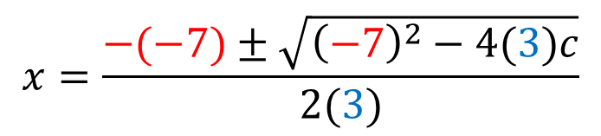
The Quadratic Formula!
Solve each quadratic equation using the quadratic formula. Give both exact and approximate answers. (Examples)
$$a) 3x^{2}−7x−6=0$$
$$a=3 b=−7 c=−6$$
$$x=\frac{−b±\sqrt{b^{2}−4ac}}{2a}$$
$$x=\frac{−(−7)±\sqrt{{\left(−7\right)}^{2}−4(3)c}}{2(3)}$$

Slide 22
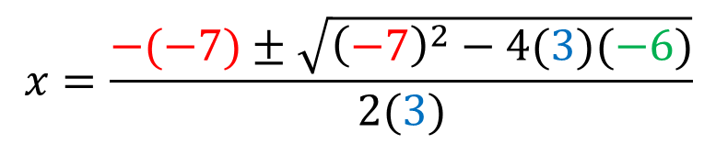
The Quadratic Formula!
Solve each quadratic equation using the quadratic formula. Give both exact and approximate answers. (Examples)
$$a) 3x^{2}−7x−6=0$$
$$a=3 b=−7 c=−6$$
$$x=\frac{−b±\sqrt{b^{2}−4ac}}{2a}$$
$$x=\frac{−(−7)±\sqrt{{\left(−7\right)}^{2}−4(3)(−6)}}{2(3)}$$

Slide 23
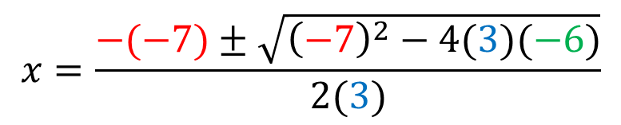
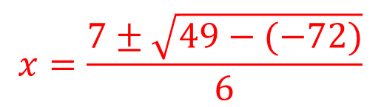
The Quadratic Formula!
Solve each quadratic equation using the quadratic formula. Give both exact and approximate answers. (Examples)
$$a) 3x^{2}−7x−6=0$$
$$x=\frac{−(−7)±\sqrt{{\left(−7\right)}^{2}−4(3)(−6)}}{2(3)}$$
$$x=\frac{7±\sqrt{49−(−72)}}{6}$$

Slide 24
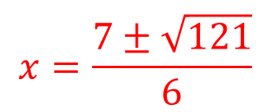
The Quadratic Formula!
Solve each quadratic equation using the quadratic formula. Give both exact and approximate answers. (Examples)
$$a) 3x^{2}−7x−6=0$$
$$x=\frac{−(−7)±\sqrt{{\left(−7\right)}^{2}−4(3)(−6)}}{2(3)}$$
$$x=\frac{7±\sqrt{121}}{6}$$

Slide 25
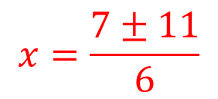
The Quadratic Formula!
Solve each quadratic equation using the quadratic formula. Give both exact and approximate answers. (Examples)
$$a) 3x^{2}−7x−6=0$$
$$x=\frac{−(−7)±\sqrt{{\left(−7\right)}^{2}−4(3)(−6)}}{2(3)}$$
$$x=\frac{7±11}{6}$$

Slide 26
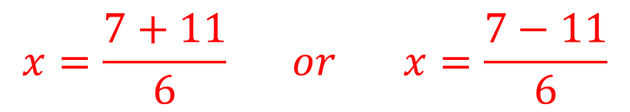
The Quadratic Formula!
Solve each quadratic equation using the quadratic formula. Give both exact and approximate answers. (Examples)
$$a) 3x^{2}−7x−6=0$$
$$x=\frac{−(−7)±\sqrt{{\left(−7\right)}^{2}−4(3)(−6)}}{2(3)}$$
$$x=\frac{7+11}{6} or x=\frac{7−11}{6}$$

Slide 27
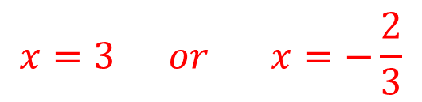
The Quadratic Formula!
Solve each quadratic equation using the quadratic formula. Give both exact and approximate answers. (Examples)
$$a) 3x^{2}−7x−6=0$$
$$x=\frac{−(−7)±\sqrt{{\left(−7\right)}^{2}−4(3)(−6)}}{2(3)}$$
$$x=3 or x=−\frac{2}{3}$$

Slide 28




The Quadratic Formula!
Solve each quadratic equation using the quadratic formula. Give both exact and approximate answers. (Examples)
$$b) 3x^{2}=−6x−1$$
$$3x^{2}=−6x−1$$
$$3x^{2}+6x+1=0$$
$$a=3 b=6 c=1$$

Slide 29

The Quadratic Formula!
Solve each quadratic equation using the quadratic formula. Give both exact and approximate answers. (Examples)
$$b) 3x^{2}=−6x−1$$
$$a=3 b=6 c=1$$
$$x=\frac{−b±\sqrt{b^{2}−4ac}}{2a}$$

Slide 30
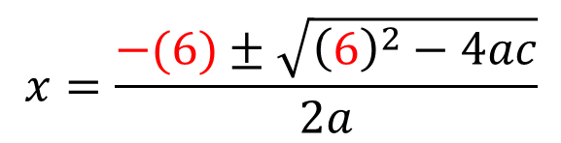
The Quadratic Formula!
Solve each quadratic equation using the quadratic formula. Give both exact and approximate answers. (Examples)
$$b) 3x^{2}=−6x−1$$
$$a=3 b=6 c=1$$
$$x=\frac{−b±\sqrt{b^{2}−4ac}}{2a}$$
$$x=\frac{−(6)±\sqrt{{\left(6\right)}^{2}−4ac}}{2a}$$

Slide 31
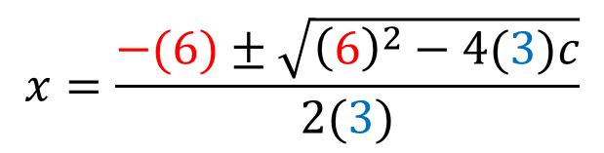
The Quadratic Formula!
Solve each quadratic equation using the quadratic formula. Give both exact and approximate answers. (Examples)
$$b) 3x^{2}=−6x−1$$
$$a=3 b=6 c=1$$
$$x=\frac{−b±\sqrt{b^{2}−4ac}}{2a}$$
$$x=\frac{−(6)±\sqrt{{\left(6\right)}^{2}−4(3)c}}{2(3)}$$

Slide 32
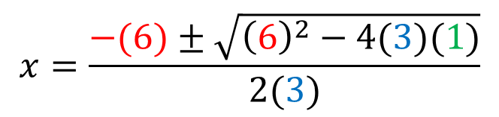
The Quadratic Formula!
Solve each quadratic equation using the quadratic formula. Give both exact and approximate answers. (Examples)
$$b) 3x^{2}=−6x−1$$
$$a=3 b=6 c=1$$
$$x=\frac{−b±\sqrt{b^{2}−4ac}}{2a}$$
$$x=\frac{−(6)±\sqrt{{\left(6\right)}^{2}−4(3)(1)}}{2(3)}$$

Slide 33
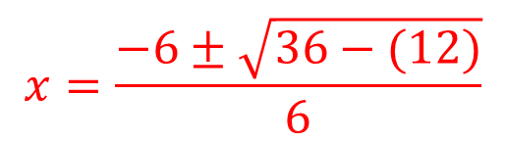
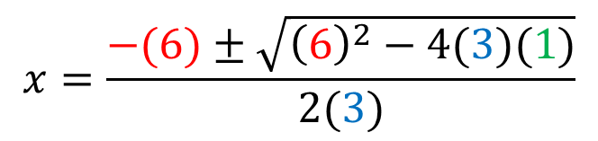
The Quadratic Formula!
Solve each quadratic equation using the quadratic formula. Give both exact and approximate answers. (Examples)
$$b) 3x^{2}=−6x−1$$
$$x=\frac{−(6)±\sqrt{{\left(6\right)}^{2}−4(3)(1)}}{2(3)}$$
$$x=\frac{−6±\sqrt{36−(12)}}{6}$$

Slide 34
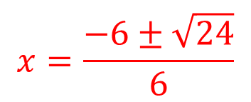
The Quadratic Formula!
Solve each quadratic equation using the quadratic formula. Give both exact and approximate answers. (Examples)
$$b) 3x^{2}=−6x−1$$
$$x=\frac{−(6)±\sqrt{{\left(6\right)}^{2}−4(3)(1)}}{2(3)}$$
$$x=\frac{−6±\sqrt{24}}{6}$$

Slide 35
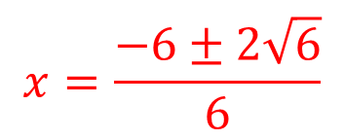
The Quadratic Formula!
Solve each quadratic equation using the quadratic formula. Give both exact and approximate answers. (Examples)
$$b) 3x^{2}=−6x−1$$
$$x=\frac{−(6)±\sqrt{{\left(6\right)}^{2}−4(3)(1)}}{2(3)}$$
$$x=\frac{−6±2\sqrt{6}}{6}$$

Slide 36
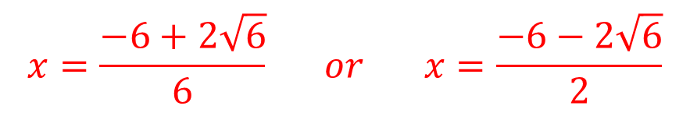
The Quadratic Formula!
Solve each quadratic equation using the quadratic formula. Give both exact and approximate answers. (Examples)
$$b) 3x^{2}=−6x−1$$
$$x=\frac{−(6)±\sqrt{{\left(6\right)}^{2}−4(3)(1)}}{2(3)}$$
$$x=\frac{−6+2\sqrt{6}}{6} or x=\frac{−6−2\sqrt{6}}{2}$$

Slide 37
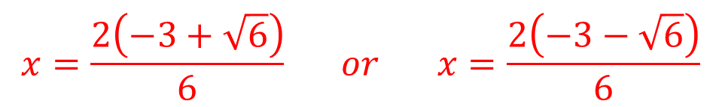
The Quadratic Formula!
Solve each quadratic equation using the quadratic formula. Give both exact and approximate answers. (Examples)
$$b) 3x^{2}=−6x−1$$
$$x=\frac{−(6)±\sqrt{{\left(6\right)}^{2}−4(3)(1)}}{2(3)}$$
$$x=\frac{2\left(−3+\sqrt{6}\right)}{6} or x=\frac{2\left(−3−\sqrt{6}\right)}{6}$$

Slide 38
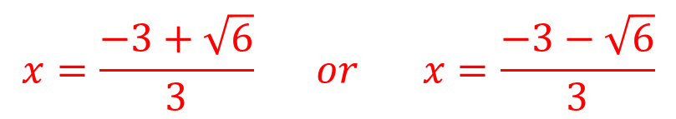
The Quadratic Formula!
Solve each quadratic equation using the quadratic formula. Give both exact and approximate answers. (Examples)
$$b) 3x^{2}=−6x−1$$
$$x=\frac{−(6)±\sqrt{{\left(6\right)}^{2}−4(3)(1)}}{2(3)}$$
$$x=\frac{−3+\sqrt{6}}{3} or x=\frac{−3−\sqrt{6}}{3}$$
(Exact answers)

Slide 39
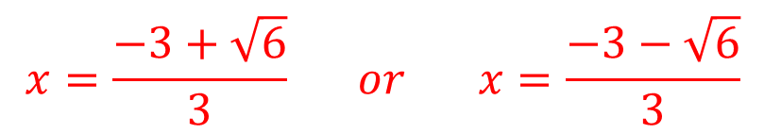

The Quadratic Formula!
Solve each quadratic equation using the quadratic formula. Give both exact and approximate answers. (Examples)
$$b) 3x^{2}=−6x−1$$
$$x=\frac{−(6)±\sqrt{{\left(6\right)}^{2}−4(3)(1)}}{2(3)}$$
$$x=\frac{−3+\sqrt{6}}{3} or x=\frac{−3−\sqrt{6}}{3}$$
(Exact answers)
$$x≈−0.18 or x≈−1.82$$

Slide 40
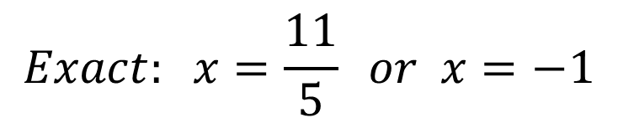

The Quadratic Formula!
Solve each quadratic equation using the quadratic formula. Give both exact and approximate answers. (Skill Check)
$$a) 5x^{2} −6x−11=0$$
$$Exact: x=\frac{11}{5} or x=−1$$

Slide 41


The Quadratic Formula!
Solve each quadratic equation using the quadratic formula. Give both exact and approximate answers. (Skill Check)
$$b) x^{2}−x=6$$
$$Exact: x=3 or x=−2$$

Slide 42
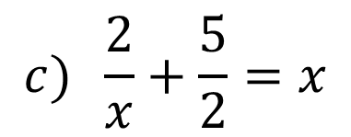
The Quadratic Formula!
Solve each quadratic equation using the quadratic formula. Give both exact and approximate answers. (Skill Check)
$$c) \frac{2}{x}+\frac{5}{2}=x$$
$$Exact: x=5+\sqrt{29} or x=5−\sqrt{29}$$
$$Approximate: x≈10.39 or x≈−.39$$

Slide 43
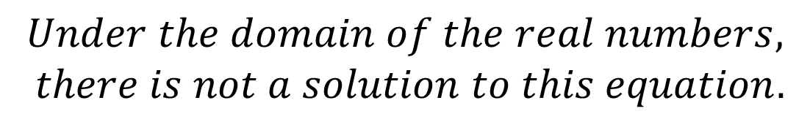

The Quadratic Formula!
Solve each quadratic equation using the quadratic formula. Give both exact and approximate answers. (Skill Check)
$$d) 2x^{2}+3x+3=0$$
$$Under the domain of the real numbers,$$
$there is not a solution to this equation.$

